Slide 1
CLASSROOM RULES
Be on time
Be interactive
100% or nothing
Do all daily challenges

Slide 2

Lesson 15
Brought to you by LangGo
MODAL VERBS
MODAL VERBS

Slide 3
REVIEW:
GRAMMAR + VOCABULARY

Slide 4
REVIEW: LISTENING
How much is this computer?
Do you want to try them on?
Only rich people can really afford to buy a car at home.
We pay a very high tax on cars.
I was kind of surprised that I could get nice clothes here for very reasonable prices.
You have to pay a lot to do that, so it’s a big expense for many people.
You need to have health insurance because it costs a lot to see a doctor or to enter a hospital.

Slide 5
REVIEW: SPEAKING
Describe a trip you would like to take in the future
Where would you like to go? Why? (Place)
Who will you go with? (People)
How will you get there? (Means of transport)
What will you do there? (Activities)
How will you feel about the trip? (Feelings)

Slide 6
OBJECTIVES
#01
#02
Understand the function and usage of common Modal verbs
Use modal verbs in Writing and Speaking.

Slide 7
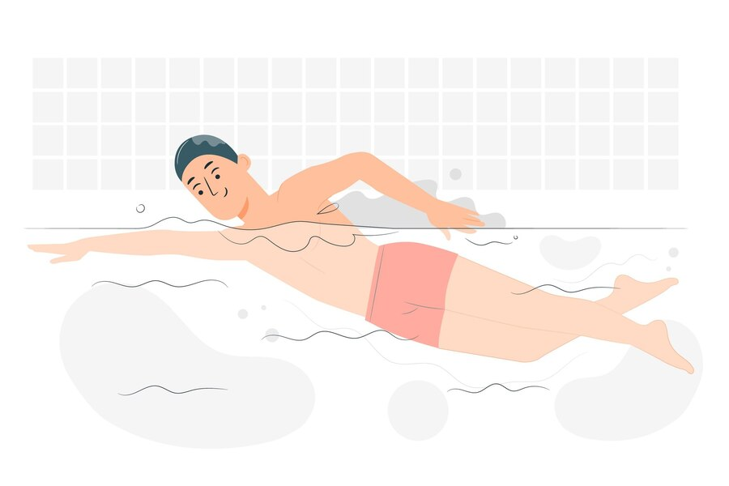
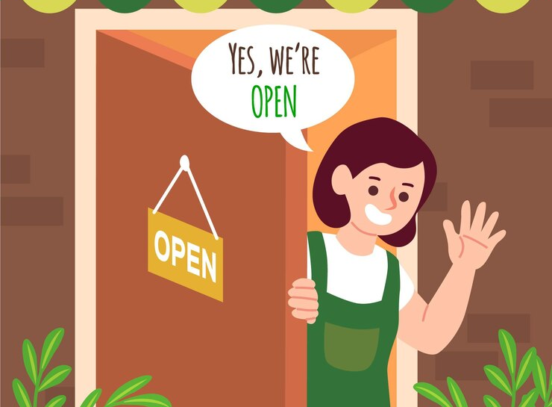
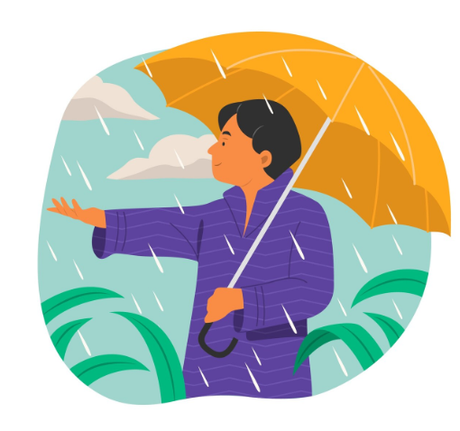
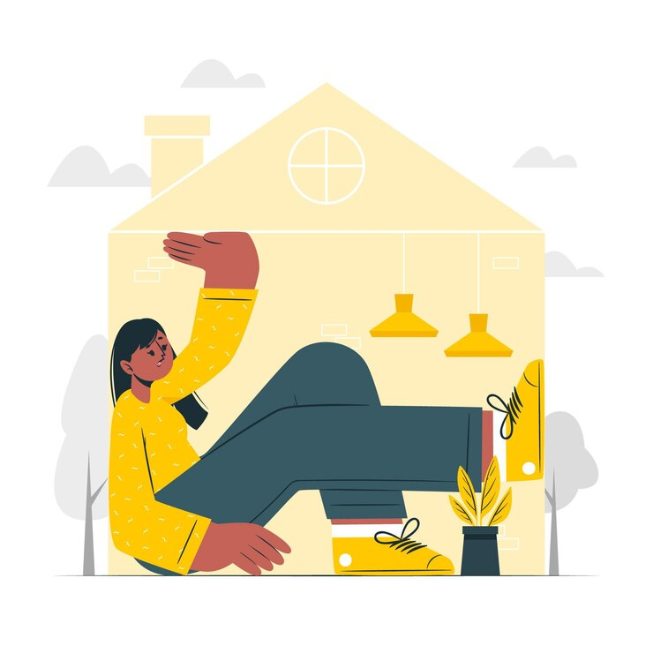
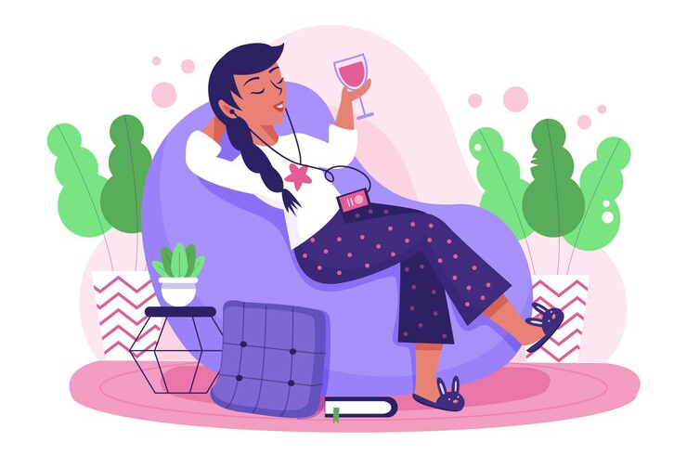
DEFINITION
A modal verb is a helping (auxiliary) verb that expresses
Ability
Permission
I can swim.
May I come in?
Possibility
Obligation
Advice
It might rain.
You mustn’t go out.
You should rest.

Slide 8
FORM
STATEMENT | NEGATIVE
can | cannot (can’t)
could | could not (couldn’t)
may | may not
might | might not
will | will not (won’t)
should | should not (shouldn’t)
must | must not (mustn’t)
All modal verbs
have only one form
I/you/he/she/it/we/they may go to the bookstore to buy some books .
are followed by the bare infinitive
do not have infinitives (no “to”)
You should call check the weather before going on a trip.

Slide 9
FORM
Semi-modals
ought to | have to | need to
“ought to” chỉ có duy nhất 1 dạng Statement: ought to Negative: ought not to | “Have to” và “need to” cần chia theo đúng chủ ngữ và đúng thì Statement: have to | need to Negative: don’t have to | don’t need to
You ought to try this dish. | They had to do housework. | She needs to buy the ticket before getting on the train.

Slide 10
ABILITY
MODAL | USE | EXAMPLE
can | Ability now or generally | She can speak 2 languages.
could | Ability in the past | Tom could read when he was two years old.
be able to | Ability in other tenses | After this course, I will be able to speak English more fluently. My sister hasn't been able to visit us much this year because she's very busy.

Slide 11

PERMISSION
MODAL | USE | EXAMPLE
may could can | Asking for permission | May/Could/Can I go shopping now?
can may | Giving permission | You may/can come in.
NOTE: Về mức độ lịch sự:
“may” > “could” > “can”.

Slide 12
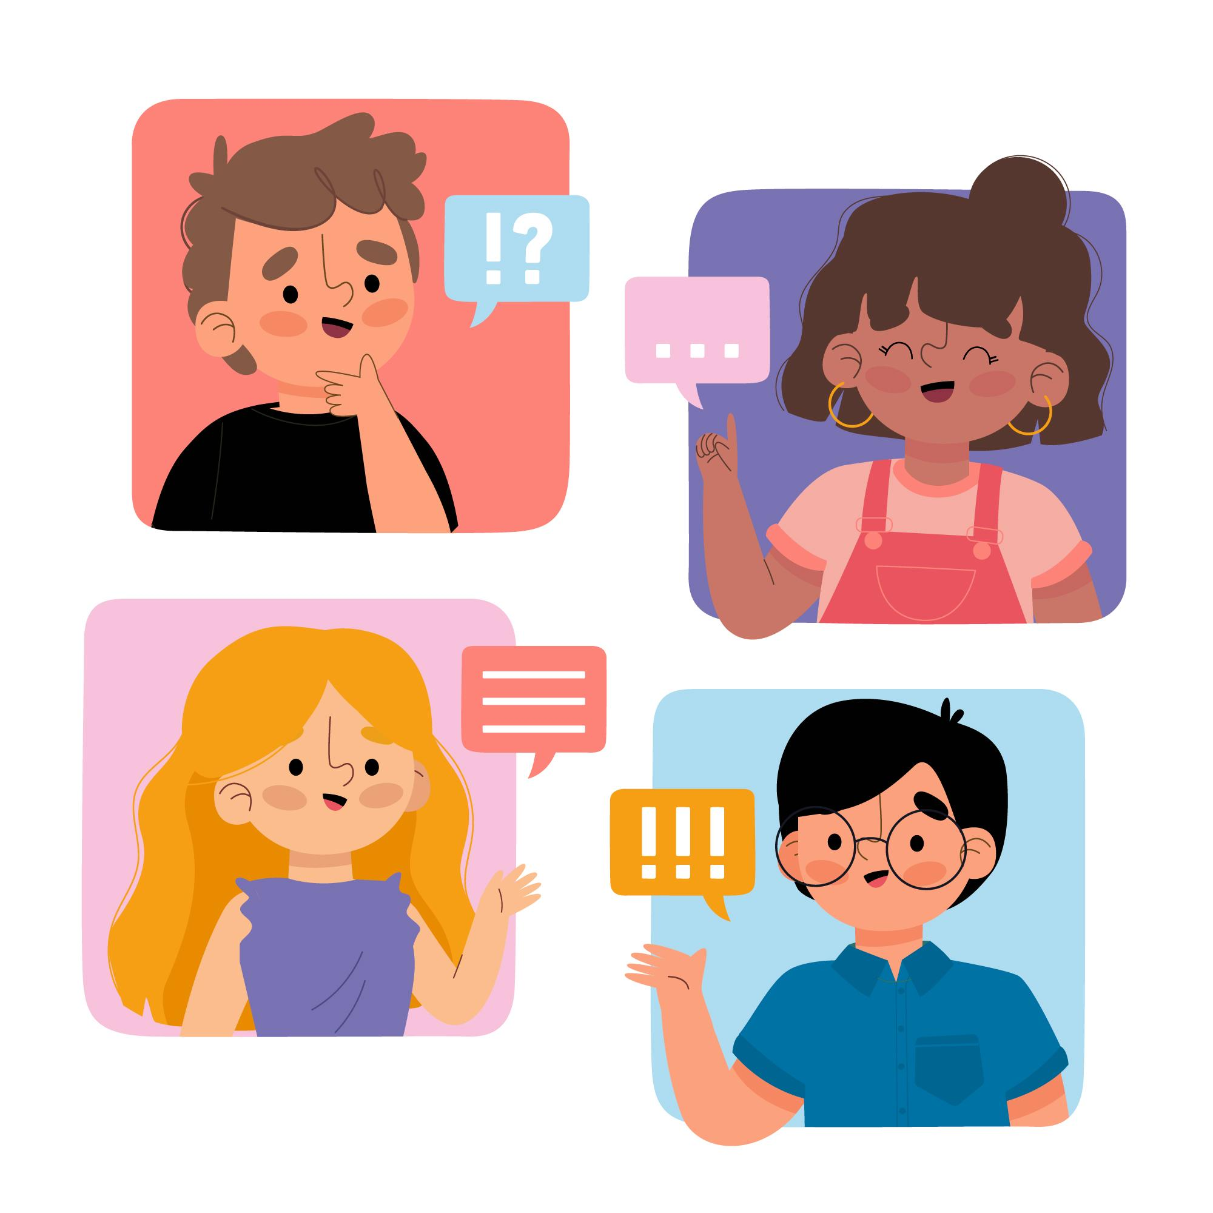
ADVICE
MODAL | USE | EXAMPLE
should ought to | Asking for and giving advice | Should I study tonight instead of going out? You should/ ought to finish your daily challenges first.

Slide 13
OBLIGATION
MODAL | USE | EXAMPLE
Must | Mong muốn từ chính người nói | You must submit your essays by Friday. (GV muốn HV làm) I must study hard for my exam tomorrow. (Tự tôi muốn học để đạt điểm cao)
Have to | Không phải mong muốn từ phía người nói, do yếu tố khác bên ngoài | I have to work on Sundays. (Tôi không muốn thế nhưng công ty bắt vậy) We have to attend at least 80% of the classes to pass this English course. (Là yêu cầu của khoá học chứ không phải mong muốn của chúng tôi)
Need to | Mức độ bắt buộc nhẹ hơn, chỉ sự cần thiết phải làm | I need to practice my pronunciation more often.

Slide 14
NOTE
You mustn’t do that! (Không được phép/ Cấm)
You don’t have to/ don't need to/ needn't do that.
(Không cần thiết phải làm)

Slide 15
PROBABILITY & POSSIBILITY
MODAL | USE | EXAMPLE
must can’t couldn’t | Khả năng rất cao ở hiện tại (có căn cứ/ bằng chứng) | The phone is ringing – it must be Simon. It can’t be my mom calling, she’s sitting next to me!
may / might | Khả năng xảy ra ở hiện tại hoặc tương lai | I’m not sure what language it is – it may / might be Polish. It may/ might rain this afternoon.

Slide 16
Key:
Fill in the blanks with the correct modal verbs. You can use the negative form. You can also use them more than once.
Could | Would | Should | Might | Had to
Last weekend, I went to a seafood restaurant with my family. It was very popular, so we _____ book a table. To start the meal, we had some fresh salad and clam soup. The soup was hot and full of flavor — you _____ try it if you visit! The main dish was grilled prawns with rice. The spices were amazing — you _____ smell the herbs from across the table. For dessert, we ordered mango pudding. It was soft, sweet, and creamy. Honestly, it _____ be the best pudding I’ve ever tasted. However, some of the dishes were a bit oily, so maybe we _____ order fried items next time.
Another great thing is the service. The staff were kind, and we _____ ask them anything about the food. It was a great experience overall. If I go back to that city, I _____ definitely eat there again!

Slide 17
Key:
Fill in the blanks with the correct modal verbs. You can use the negative form. You can also use them more than once.
Could | Would | Should | Might | Had to
Last weekend, I went to a seafood restaurant with my family. It was very popular, so we had to book a table. To start the meal, we had some fresh salad and clam soup. The soup was hot and full of flavor — you should try it if you visit! The main dish was grilled prawns with rice. The spices were amazing — you could smell the herbs from across the table. For dessert, we ordered mango pudding. It was soft, sweet, and creamy. Honestly, it might be the best pudding I’ve ever tasted. However, some of the dishes were a bit oily, so maybe we shouldn’t order fried items next time.
Another great thing is the service. The staff were kind, and we could ask them anything about the food. It was a great experience overall. If I go back to that city, I would definitely eat there again!

Slide 18
Food and drink
- Restaurant

Slide 19
What are your favorite foods/drinks?
Use the structures for likes/dislike in the previous lesson!
My favorite dish is… I love eating/having…. for breakfast/lunch/dinner My comfort dish is….. I always eat…

Slide 20
2. Are they good for you?
Yes, …
They are good for my health/ they are healthy because they have a lot of vitamin/protein.
No,..
They are unhealthy because they contain a lot of oil, sugar, and salt.

Slide 21
Talk about a restaurant that you went to:
Where you went:
I went to a seafood/steak/fast food restaurant with my family / friends / classmates.
It was near my hotel / in the city center / in my hometown, => so we could walk/ get there by car/ had to take a taxi to get there.
Why you went:
We went there for dinner.
It was my birthday / a special day, so we wanted to celebrate.
We wanted to try something new.
What you ate:
To start, we had soup / salad / bread.
The main dish was chicken rice / steak / seafood noodles.
For dessert, we had ice cream / fruit / cake.

Slide 22
The food:
The food was tasty / delicious / fresh. My favorite dish was …
You should try it if you visit there!
The service:
The staff were kind, and we could ask them anything about the food.
The waiter was kind / helpful / friendly.
We didn’t have to wait long.
What you didn’t like:
Unfortunately, it was too salty / a little oily / not very good.
I had a stomach ache after eating it. I had to go to the hospital afterwards.
Would you go again?
If I go back to that city, I would definitely eat there again!
I may try other dishes next time.

Slide 23
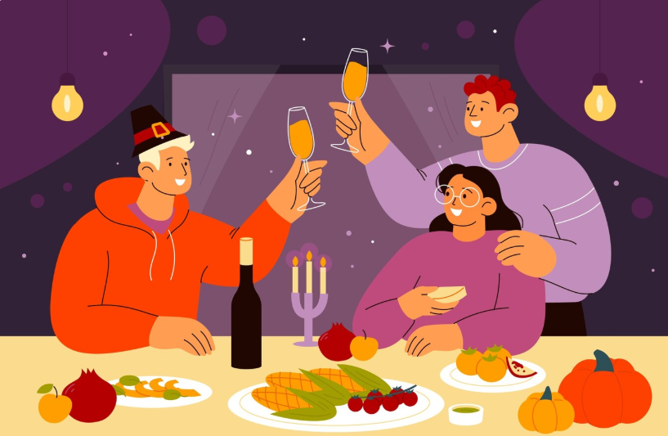
LET’S PRACTICE SPEAKING:
Describe your trip to a restaurant

Slide 24


DON’T FORGET TO COMPLETE YOUR DAILY CHALLENGES.
GOODBYE
GOODBYE

